Slide 1
HAND DETECTION TRACKING
NAGARAJU OBBINENI
BHARATH SIVA KUMAR YELAMANCHILI
HARSHA KUMAR PULLA
KAUSHIK KOLLA

Slide 2
ABSTRACT
This paper has been proposed with the view of eliminating the concern of getting contacted with contagious diseases with the use of public access computers and improving the experience of interacting with the computers. The goal is to use hand motions caught by the webcam to gain control of the mouse and its functionality. The users can move the mouse cursor's direction and perform all mouse operations with their hands positioned in front of the webcam. To the extension of the above-mentioned aim and as an enhancement in the usage of the model, this increment focus on the addition of VoiceOver to the mouse movements on screen.

Slide 3
INTRODUCTION
Direct use of hands is a fundamental way for humans to communicate with each other and, more recently, with gadgets in intelligent surroundings, hence vision-based hand gesture detection is an active topic of research in human-computer interaction (HCI).
The trend in human-computer interaction is heading toward real-time hand gesture recognition and tracking for usage in video games, remote-free television control, and other similar applications.
This work presents the implementation and analysis of a vision-based static hand position estimate system.

Slide 4
1. Problem Specification:
If you're delivering a presentation using a projector and want to move the slide but don't have a laser pointer, do you have to walk all the way to the podium and then change the slide?
There are a variety of instances in which this gesture control is required to make the job safe and smart.
2. Problem Analysis:
Understanding the above-mentioned real-world problems and the needs of a user to deal with, we propose a solution wherein using a web camera and fingertip tracking, users may remotely control their computer mouse with their bare hands. A python library called Media pipe is being used as an instrumental tool in extracting the hand region, which is then filtered using morphological opening processes and blob labeling.

Slide 5
The convex hull and convexity defect are then utilized to count the fingers and determine the fingertip locations. The fingertip coordinates are then transferred to the screen coordinates and smoothed using the Moving Average. Finally, the events associated with the identified fingers are relayed to the computer system to control the mouse. The experimental findings reveal that the suggested approach can count the finger with 98.3 percent accuracy and perform effectively in real-time.

Slide 6
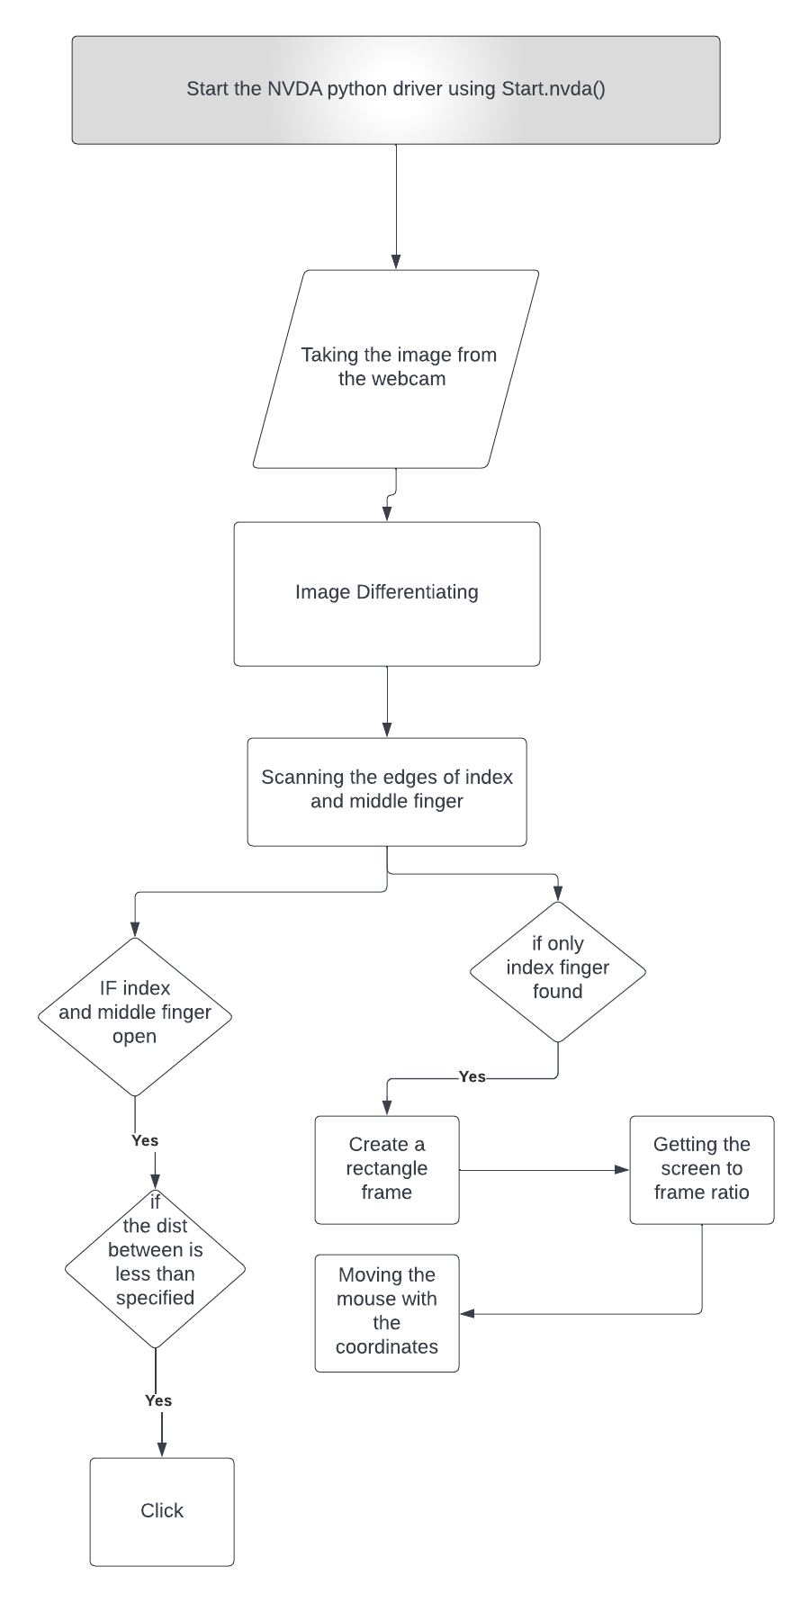
DESIGN
PROPOSED SYSTEM:
The suggested solution makes use of a few Python packages, including open cv, media pipe, autopy, and pyautogi.
To begin, in order to read the picture from the camera, we utilize the OpenCV library.
The picture is then converted from BGR to RGB using the opencv function cvtColor() as a Media pipe library Hands is a function that takes an RGB picture and returns the hand landmarks.
Using the landmark, we get the fingertips, which are easy to recognize.
We also draw a rectangle to keep our fingers from moving outside the scope of the screen and to make it easier to reach the screen's edges.

Slide 7
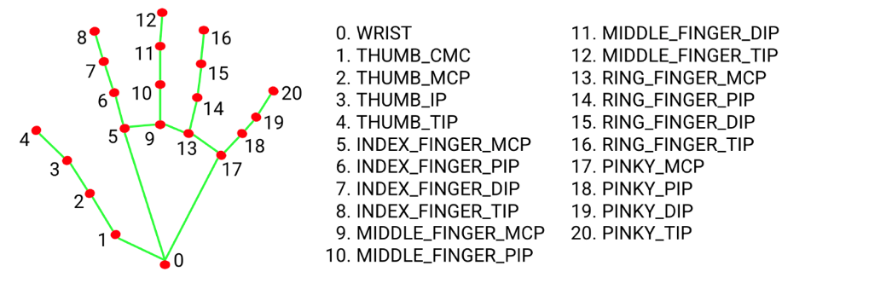
We acquire access to mouse the pointer from the specified coordinates by utilising the library called autopy or pyautogui, and if the index and middle fingers get near, it executes the click function.

Slide 8
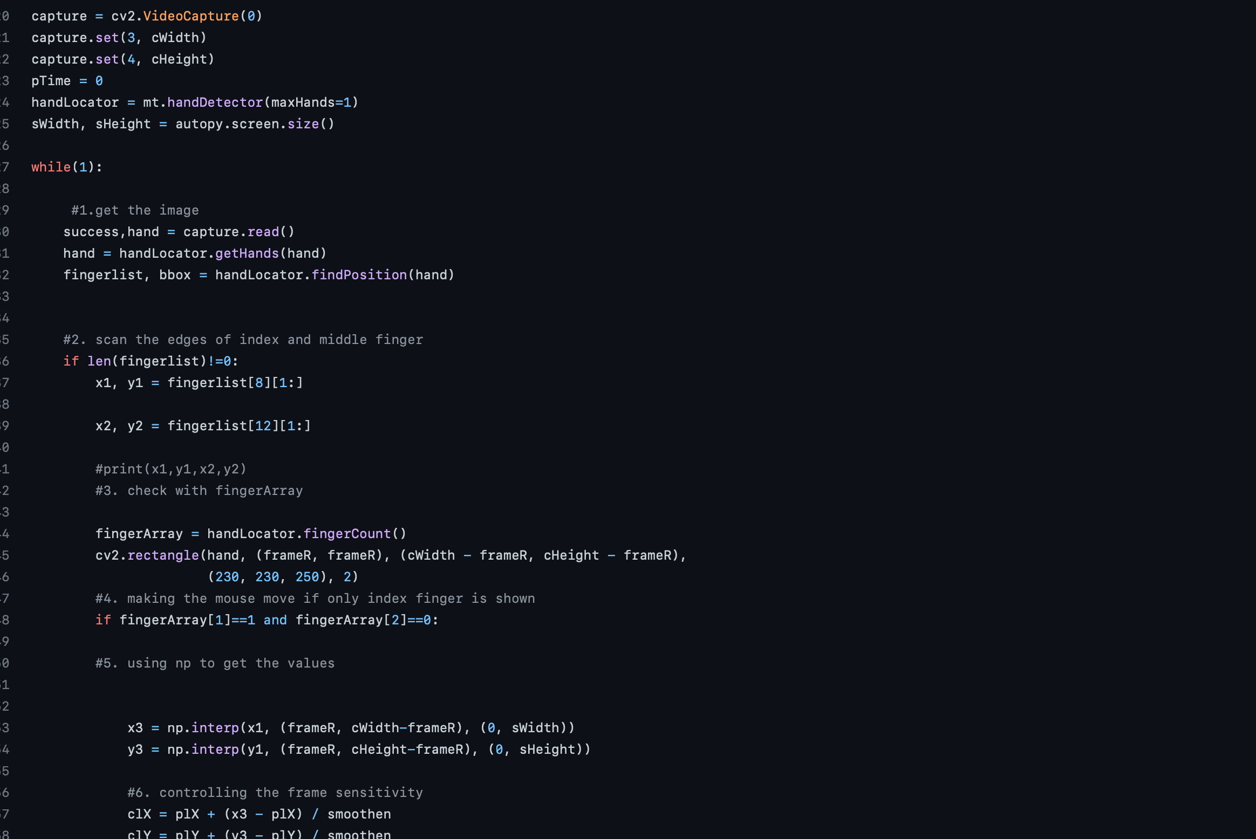

Slide 9
FUTURE ENHANCEMENT
We would like to add few more additional gestures and perform a thorough analysis of utility addition of voice over commands.
In addition to this we would like to make the system interactive not limiting the mouse controlling system to just open, close, or select certain files, we want to use the hand-gestures movements to use the mouse pointer to scribble in a word or text document and want to implement a machine learning algorithm to convert the irregular text into a regular format.

Slide 10
REFERENCE
https://link.springer.com/article/10.3758/s13428-019-01258-6
http://pascalkieslich.github.io/mousetrap/
https://www.gnu.org/software/emacs/manual/html_node/elisp/Mouse-Tracking.html

